Slide 1

Statistics
Aishwarya mate

Slide 2










Random Variable and Probability
Any event can be called as a random variable if it follows below 2 rules:
Event must take more than a single value
There should be some associated probability with every possible answer event can take.

Slide 3

Probability Distributions
1️⃣ Describe Uncertainty Systematically They quantify the likelihood of different outcomes in uncertain situations (e.g., rolling a die, customer arrivals in a store).
Let’s understand with example!

Slide 4
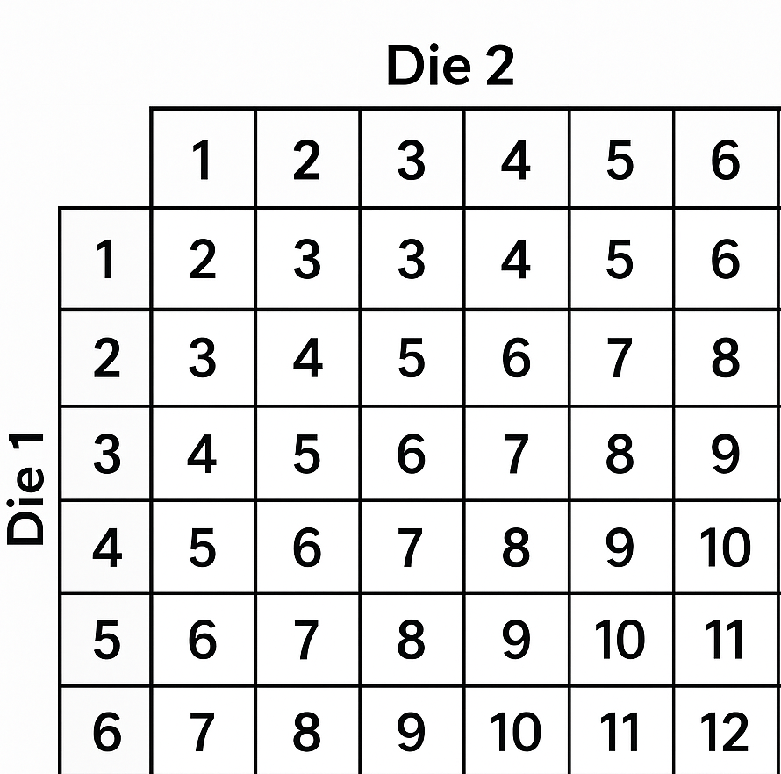
Problem statement: If you roll 2 dices together, What is the probability that sum of faces of those 2 dice will be 5?

Slide 5
Normal Distribution
A Normal Distribution is a continuous probability distribution that is symmetrical and bell-shaped, where most of the data points are concentrated around the mean.
It is used to find out the probability associated with a value.
What is the probability that tomorrow’s temperature will be between 20 to 25?
What is the probability that company will sell 50k to 60k products?

Slide 6
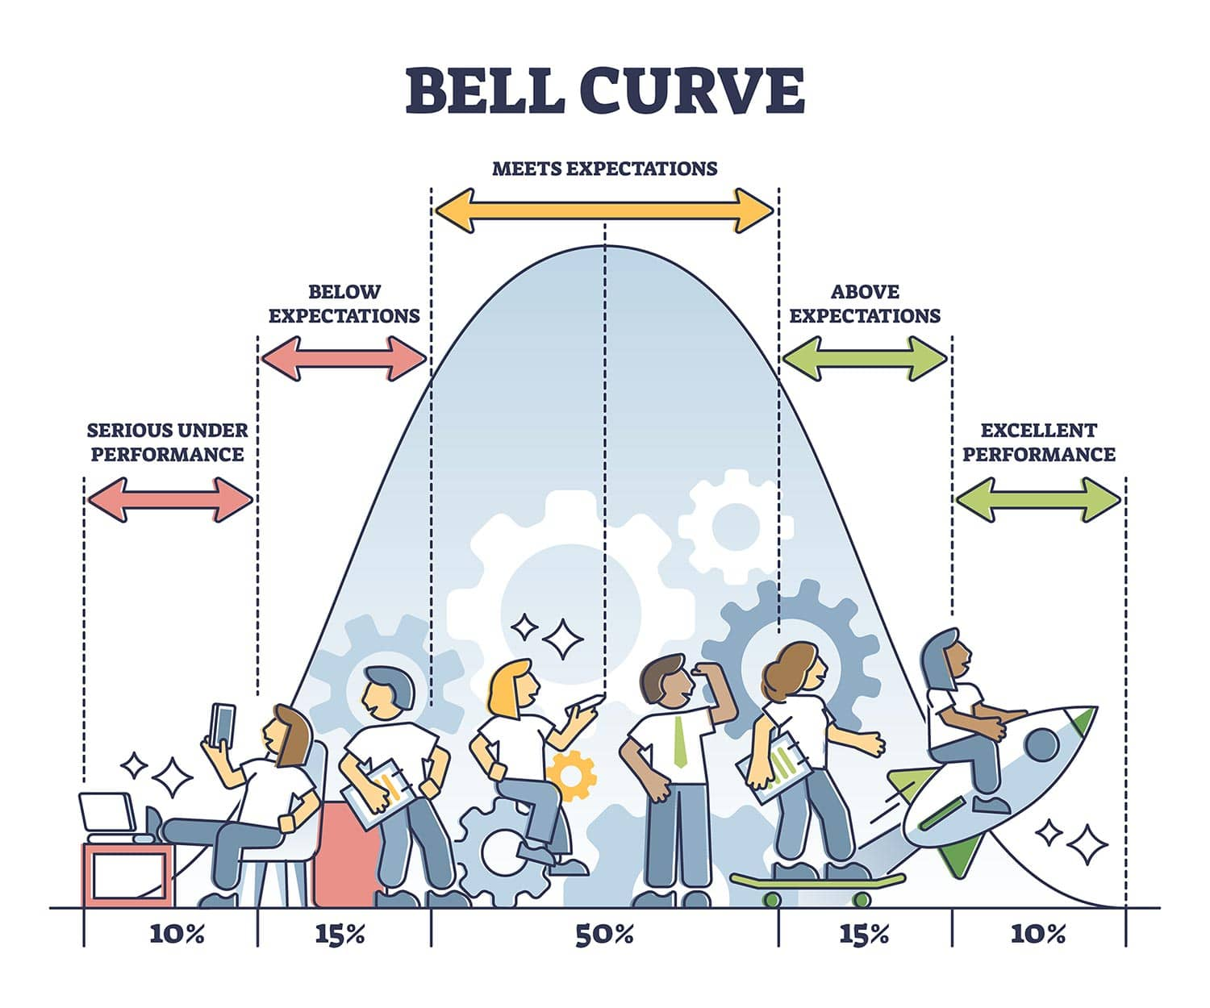
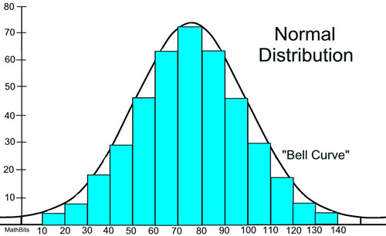
Normal distribution

Slide 7
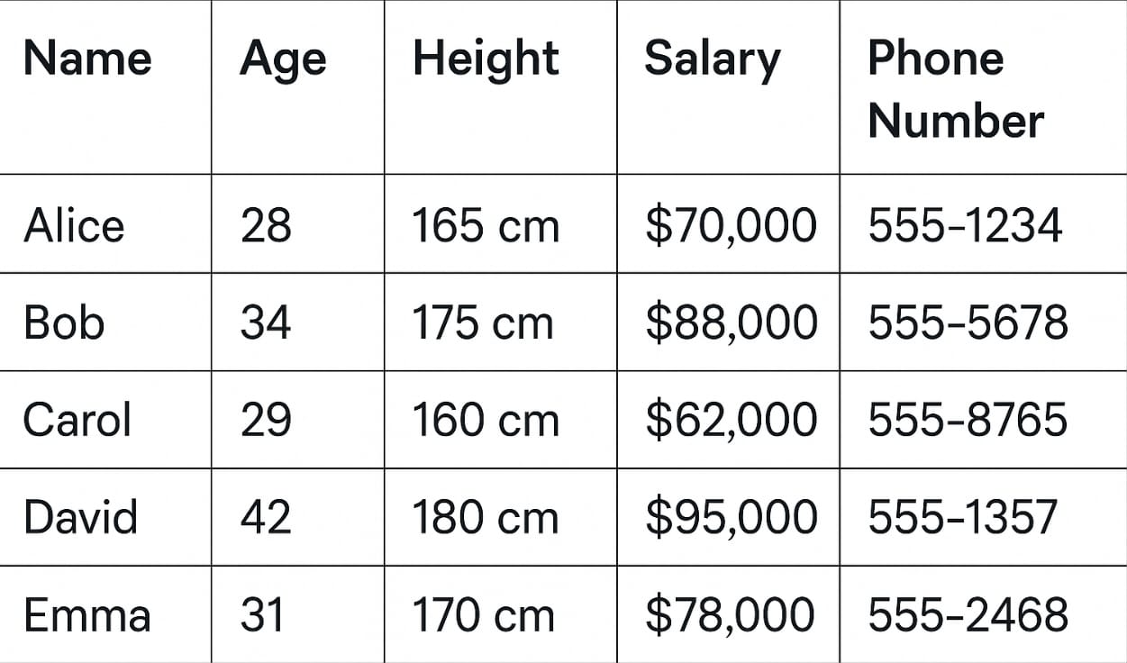
Standard Normal Distribution
🚩 What makes it Standard?
A Standard Normal Distribution is just a normal distribution that is standardized to:
Mean (average) = 0
Standard Deviation = 1
✅ Why do we set mean = 0 and standard deviation = 1?
It makes calculations easier.
It allows us to compare different datasets on the same scale.
We can use Z-tables to quickly find probabilities.

Slide 9
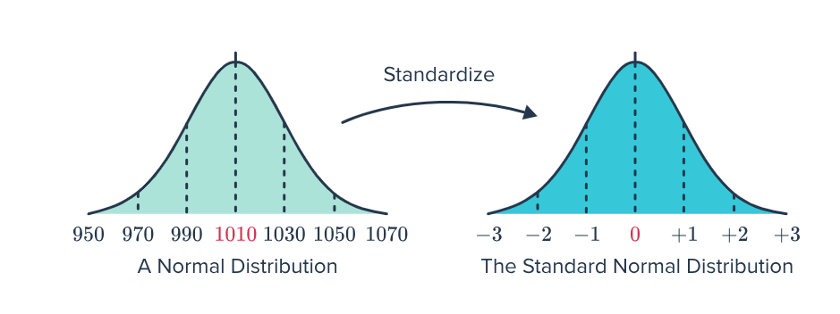
Standard Normal distribution

Slide 10
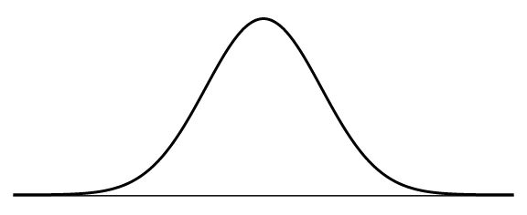
Normal distribution for probability
What is the probability that tomorrow’s temperature will be exactly 25?
Probability associated with a single value is always zero!

Slide 11
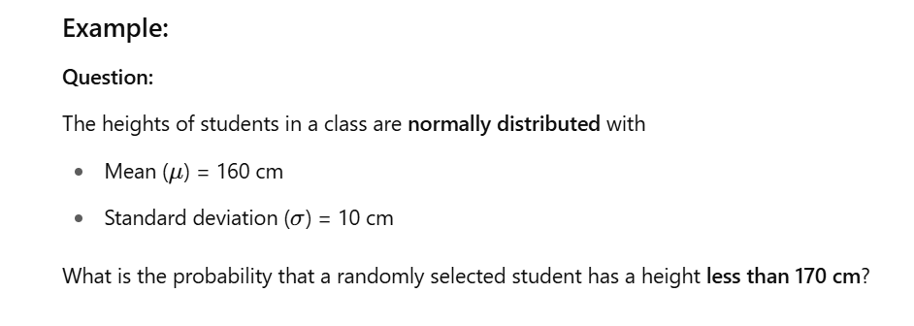
Normal distribution for probability

Slide 12
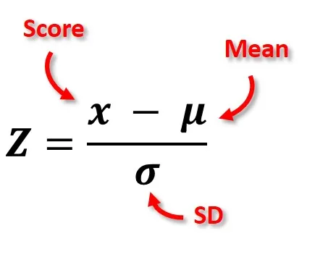
Normal distribution for probability
from scipy.stats import norm
probability = norm.cdf(z)

Slide 13
In class activity
A factory produces rods with lengths that are normally distributed with a mean of 100 cm and a standard deviation of 4 cm. Find the probability that a randomly selected rod is longer than 106 cm.
2. The heights of male students in a university are normally distributed with a mean of 175 cm and a standard deviation of 8 cm. What proportion of students are taller than 185 cm?

Slide 14
Thank You!

